Slide 1

Student Details
Name : Shanmukh Pabbisetty
Email ID : lakshmisaipabbisetty_shanmukha@srmap.edu.in
College Name :SRM University, AP
Internship Domain : Cybersecurity with kali linux

Slide 2
PROJECT TITLE/Problem Statement
Image steganography
These days privacy is getting compromised because of hackers to make data transfer in such away that data is hidden from others other than sender and receiver.

Slide 3
AGENDA
In real world privacy plays a major role but in case of highly secured data, transferring them with high security is needed. To do this kind of data transfers Image steganography is used.
There are many kinds of steganography but here we developed this code for image steganography
By using Image steganography data is hidden in such away that the others see the cover image but the intended sender and receiver see the hidden data with the help algorithm

Slide 4
PROJECT OVERVIEW
Design and implementation of an advanced steganographic system for information hiding in digital images. Very importantly, this system should ensure that the human eye does not reveal the hidden data; at the same time, the technique applied in this process remains resilient to image processing operations like compression and resizing. This would further enhance the security and confidentiality of data through its processing in a digital communication setup.

Slide 5
WHO ARE THE END USERS of this project?
The end users include security professionals, government agencies, corporate entities, researchers and academics, privacy advocates and software developers. The common factor among all these end users is their need for secure communication and data protection. Each group seeks to ensure that sensitive information remains confidential and is not easily accessible or detectable by unauthorized parties.
Military and Intelligence Agencies : Steganography is often used by military and intelligence agencies to send confidential information covertly. This helps in preventing the interception and detection of sensitive communications
Criminal Organizations : Unfortunately, criminal groups and individuals, including hackers and cybercriminals, also use steganography to hide malicious code, communicate secretly, or transport illegal data without detection.

Slide 6
YOUR SOLUTION AND ITS VALUE PROPOSITION
Solution:
This would be a highly suggested advanced image steganography system in which to securely embed and extract hidden information within a digital image. It shall use very sophisticated algorithms so that a human viewer does not get any feel of its imperceptibility, and it is resilient against normal image processing operations like compression, resizing, and format conversions.
Value Proposition:
High Security Level : The system provides a high security level by imperceptibly embedding the information within the desired data, hence making sensitive data completely secure from unauthorized access and interception
Resilient to Image Processing : It resists compression, resizing, and format change, which are common image manipulations. This strength allows one to be sure that, despite different image manipulations, the embedded data will be preserved and, hence, restored.

Slide 7
How did you customize the project and make it your own
Developed project user friendly and a simple one
Tried with many things like encrypting by taking passwords and decrypting with that respective password but this idea was good but the major point was how password is know to the receiver

Slide 8
MODELLING
Define the conceptual framework: how data can be embedded and extracted and still be secured information in terms of not being distorted in the quality of the image
Design of algorithms: Develop the most effective algorithms for embedding and extracting data.
Test robustness: see the system in terms of image manipulation resistance and eventually add error handling.
Evaluate Efficiency: Measure resource utilization and system scaling using the appropriate performance measures.
Carry out validation: This aims to test if the system meets the goals set up for its security, robustness, and efficiency

Slide 9

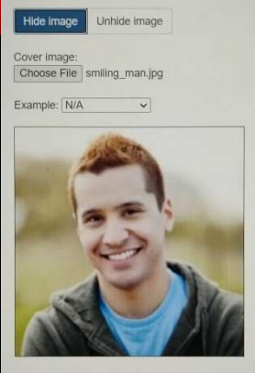
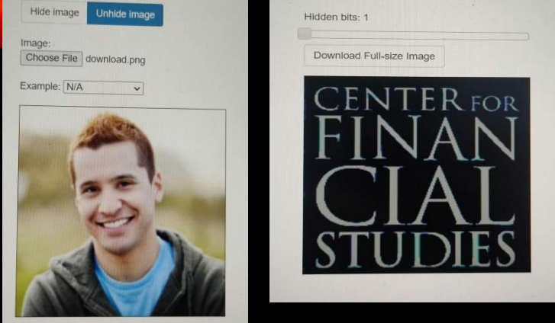
Results
Text to be Hidden
Cover Image
Shown Image
Hidden Text in Image

Slide 10
links
https://www.javatpoint.com/image-steganography-using-python
https://www.geeksforgeeks.org/image-based-steganography-using-python/

Slide 11


